Slide 1

D*SCRIPT
Author Identification for Handwritten Documents
11/18/15

Slide 2
Agenda
Programmatic:
Introduction
Challenge Scope
Milestones
Milestone Expansion:
Background
Technical approach
Open problems
Visual interface
Discussion:
Sponsor involvement
Technology transfer

Slide 3
Introduction
Problem:
Identify the author of a handwritten document
Rank author similarity from query document to database
Suggestions (not hard decisions) based on confidence values
Motivation:
Scalability: address large quantities of documents collected over long periods of time
Automation: free limited SME personnel time and load
Data pruning: focus SME attention on relevant documents
Approach:
Use deep learning to find features salient to ID author
Notes:
Important to note, this is not a hard decision:
Confidence values
Author similarity based on rank
Analyst can go through and parse most similar documents

Slide 4
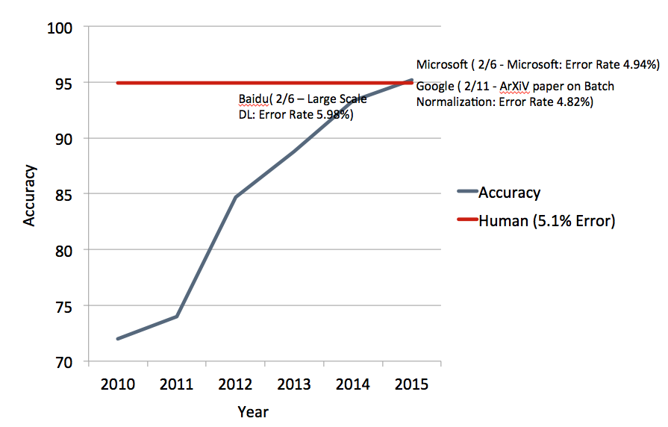
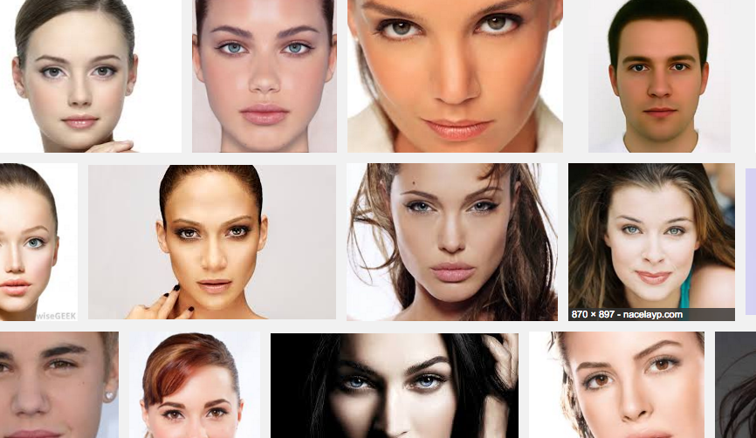
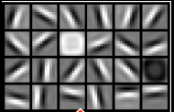
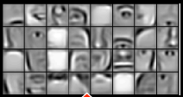
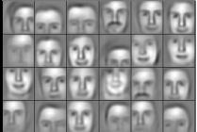
Background on Deep Learning
Performance on images
2012 DL used for the first time on challenge
Beats state of the art by a large 10% margin
Bests human performance 2/6 and 2/11 this year
Deep learning algorithms are best at feature extraction:
Natural Images
Learned 1st Layer
Learned 2nd Layer
Final Feature Layer
Notes:
----- Meeting Notes (11/12/15 11:16) -----
Up front: exploit deep learning/machine learning within the context of recognition at scale

Slide 5
Terminology & Scope
Online versus offline handwriting
Online – temporal data (i.e., as the writer is writing) is captured and modeled
Offline – no temporal data, just an image of writing
Identification versus retrieval
Identification:
Is a written document 1 of N known authors?
Retrieval:
Are two written documents written by the same author?
Preprocessing
Normalization – changing the scale/skew/lighting so that machine algorithms can train/test
Noise injection – noise TBD (discussion)
Segmentation – taking relevant portions of the image
Augmentation – increasing dataset size by slightly modifying input in ways that are photorealistic

Slide 6
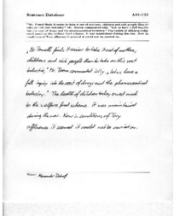
Challenge Scope
Things we are looking at
Author text only in limited free form documents
Areas of research
Initial Work
Training Sets
Handwriting
Sample
Data Preprocessing
Classification Algorithms
Author ID
Handwriting
Samples
Time Permitting
Feature Extraction
Retrieval Algorithms
Author
Similarity

Slide 7
Milestones
Type | Description | Date (Range)
Kickoff | HQ: IQT + Challenge Participants | Nov 18
Task 1 | Literature Review | Begin Nov 19
Task 2 | Dataset Procurement | Begin Nov 19
Task 3 | Dataset Preprocessing | Begin Dec 4
Deliverable 1 | Replicating State of the Art & Evaluation: CNNs | Jan 4 – Feb 1
Deliverable 2 | Algorithmic Improvements: CNN+RNNs, CNN+HMMs | Feb 1 – March 1
Deliverable 3 | User interface | March 1

Slide 8


Task 1: Literature Review
Preprocessing
Data parsing methodologies
Academic & commercial
Feature-based methodologies
Statistical Hidden Markov Models (Pre-2010)
Online & offline
Difficult to implement (no source)
Convolutional Neural Networks (2014)
Recent work on ICDAR datasets, claims ~90%
Recurrent Networks (Recent)
Previously applied to online handwriting recognition
Applied to offline handwriting with limited success

Slide 9
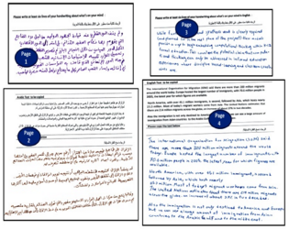

Task 2: Dataset Procurement
Current work on IAM Handwriting Database
NMEC Dataset
NMEC dataset
15GB – How about unmanipulated/clean dataset?
Imagemagick parameters for additive noise
Captricity discussion
English corpus
657 writer contributions
1,539 pages of scanned text
115,320 isolated & labeled words
Additional corpora:
ICDAR 2013
ICDAR 2015

Slide 10
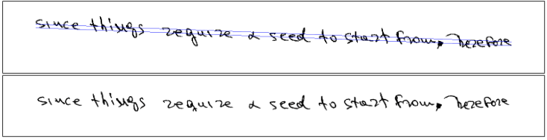
Task 3: Data Preprocessing
Data Preprocessing
Scale normalization
Line separation
Text identification
Deep learning requires lots of data
How much data?
problem complexity α parameters parameters α data required
Data augmentation
W/R/T handwriting, this will be different: noise injection, rotation and scale, skew, & lighting
Make sense for TDY to aid with this?
Ingestion into machine learning algorithms:
Patch segmentation
Segment and normalization

Slide 11
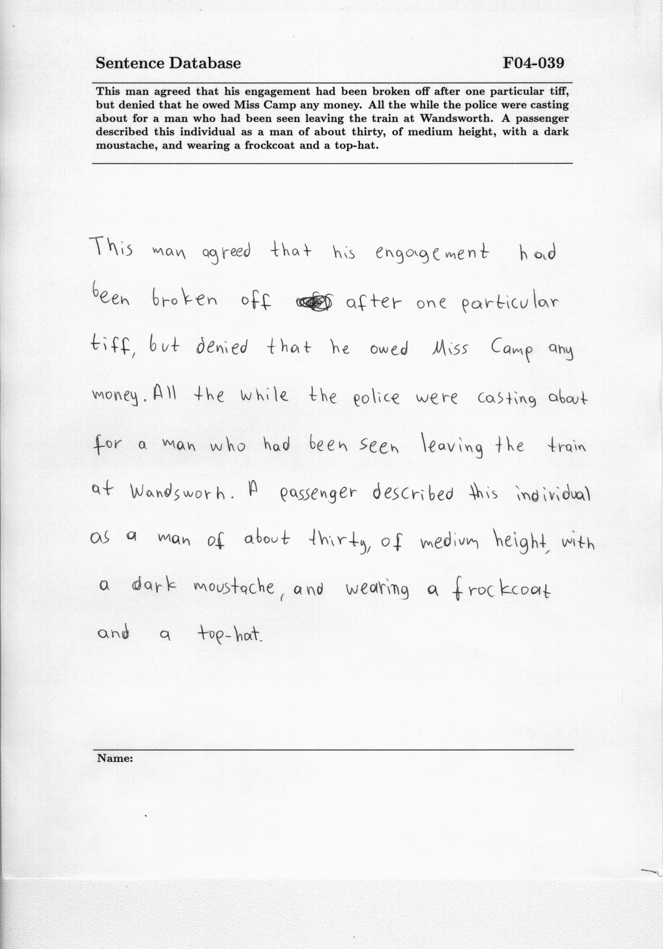
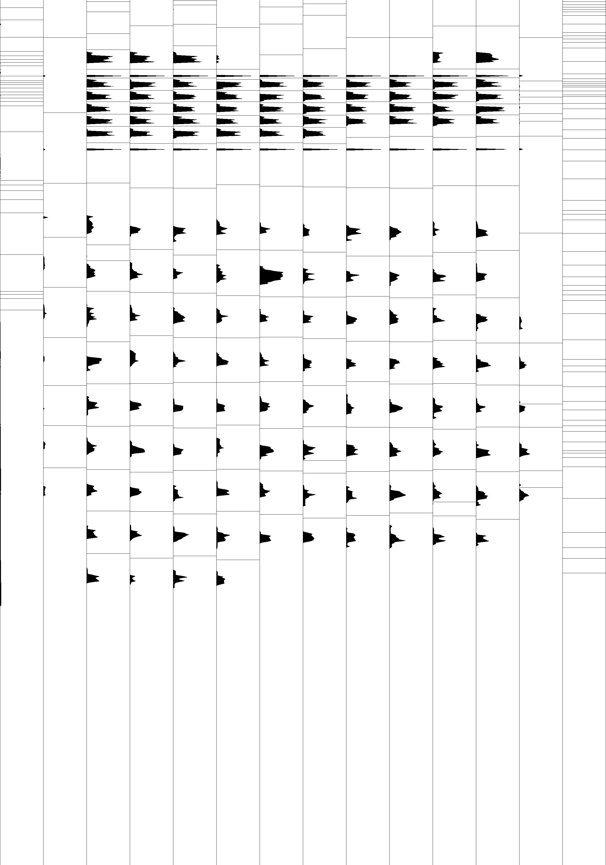
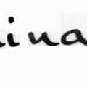
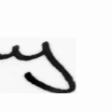
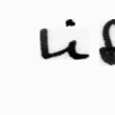
Task 3: Data Preprocessing
1) Raw Document
3) Segment and Normalize lines
2) Find patches of writing
4) Extract line segments (CNN)
Notes:
----- Meeting Notes (11/12/15 11:16) -----
Scope: English
Within context of English text
Purely printed

Slide 12
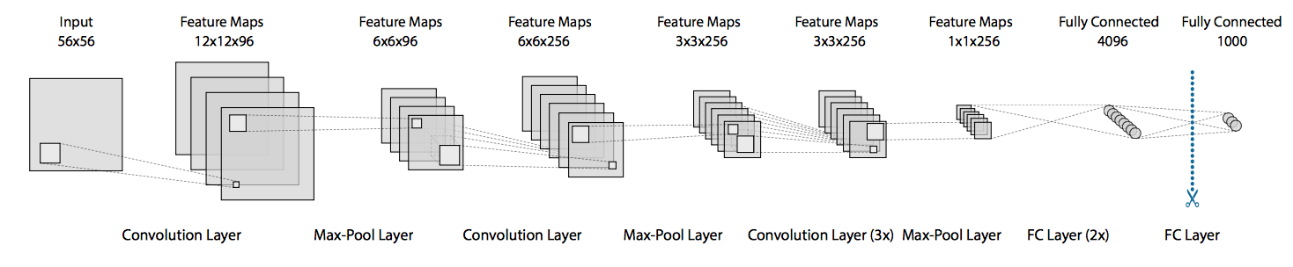
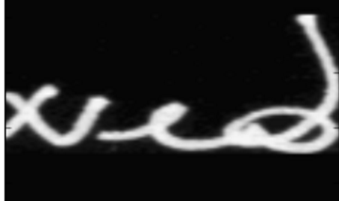
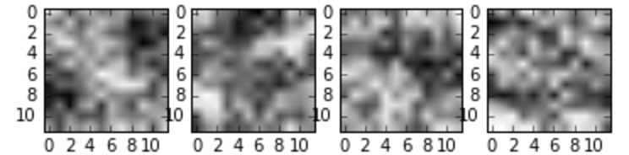
Deliverable 1: State of the Art
Approach:
Use Convolutional Neural Networks (CNN)s to generate features to compare test set authors to database
Detailed Approach (machine learning in general):
Cut the document up into lines
Align the lines horizontally
Cut lines up into uniformly distributed shards
Train classifier to recognize set of authors from shards
Use trained classifier as a feature extractor
Use feature extractor as a means to distill images down to fixed dimensional descriptor
Normalized Shard
Filter Weights: Conv 1, Acc: ~70%, 1ks

Slide 13
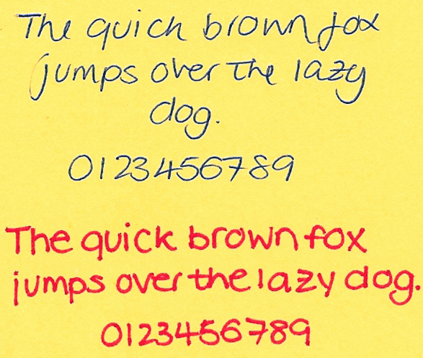
Deliverable 2: Augment Technology
Sequential modeling of handwriting
Markov modeling
Statistical & state-based
Recurrent networks
Recent success using sequential information for various stylistic tasks: authorship style, translation
Online handwriting stylistic recreations
Document level neural network inference
Pass in the entire document, output an author
Localization of specific attributes, indicative of author
Additional Capabilities:
Support for a variety of languages
Multiple writers in a single document
Writings in the margin
Notes:
----- Meeting Notes (11/12/15 11:16) -----
Multiple models

Slide 14
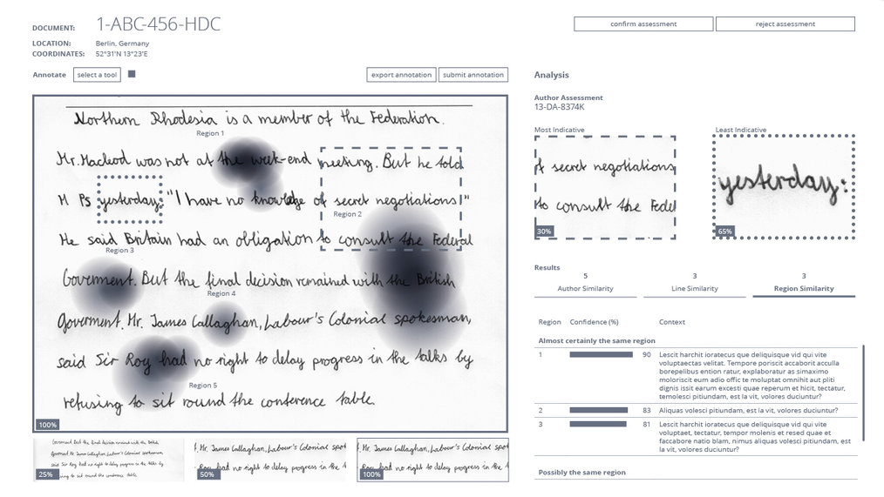
Deliverable 3: Visualization
Notes:
----- Meeting Notes (11/12/15 11:16) -----
Interface
Already has some program; easy integration
What are the existing programs

Slide 15
Documentation
Internal
Determining parameter settings and tuning
Identifying areas where algorithms will fail
Public facing
Technical blog(s)
Academic paper
IEEE International Conference on Machine Learning
Open source code

Slide 16
Discussion
Success metrics
Performance evaluations
Scenario adaptation
Sponsor involvement
Dataset procurement and support
Temporary duty assignment expectations
Timeframe (January/February)
Developers from both I2C & NMEC
Subject matter expert interactions
Algorithmic direction
Visualization interface
Continuous updates/conversations (weekly)
Technology transfer
Responsible POC for starting process
Timeline to ingest software
Software approvals
Software training: support from IQT, Lab 41
Notes:
----- Meeting Notes (11/12/15 11:16) -----
NMEC evaluation of Sciometrics
How did they do the evaluation
Signature-based research/baseline + handwriting
Frame of mind

Slide 17
Schedule Discussion
Type | Description | Date (Range)
Kickoff | HQ: IQT + Challenge Participants | Nov 18
Task 1 | Literature Review | Begin Nov 19
Task 2 | Dataset Procurement | Begin Nov 19
Task 3 | Dataset Preprocessing | Begin Dec 4
Deliverable 1 | Replicating State of the Art: CNNs | Jan 4 – Feb 1
Deliverable 2 | Algorithmic Improvements and Evaluation | Feb 1 – March 1
Deliverable 3 | User interface | March 1
Potential TDYs

Slide 18


Calendar Discussion
Type | Date (Range)
Kickoff | Nov 18
Task 1 | Begin Nov 19
Task 2 | Begin Nov 19
Task 3 | Begin Dec 4
Deliverable 1 | Jan 4 – Feb 1
Deliverable 2 | Feb 1 – Mar 1
Deliverable 3 | March 1

Slide 19
Backup

